Slide 1


FYP
Plant Disease Detection Using Mobile Application
Syed Hasnain Imran(1653-2021)
Khadija Rashid Mughal (1814-2021)
Zainab Jamil(2179-2021)
Supervisor: Sir Waqas Pasha
Department of Computing, FEST
Hamdard University

Slide 2
Summary
Introduction
Why we choose this project?
Problem Statement
Objective
Project Scope
Flowchart
Dataset
Result
Application UI
Future Work
Conclusion

Slide 3
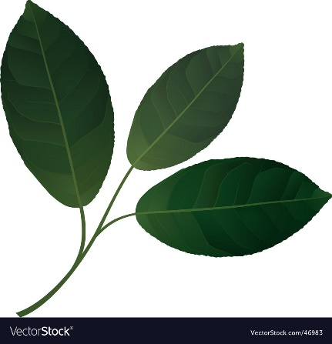
Introduction
This Project Plant Disease Detection designed specially for nursery workers, farmers or plant care takers.
This app allows users to upload or capture image of plant leaf, which is then analyzed by machine learning model to detect weather the plant is healthy or infected.
After detection the app display symptoms, provides care treatment and allows users to download a PDF report.

Slide 4
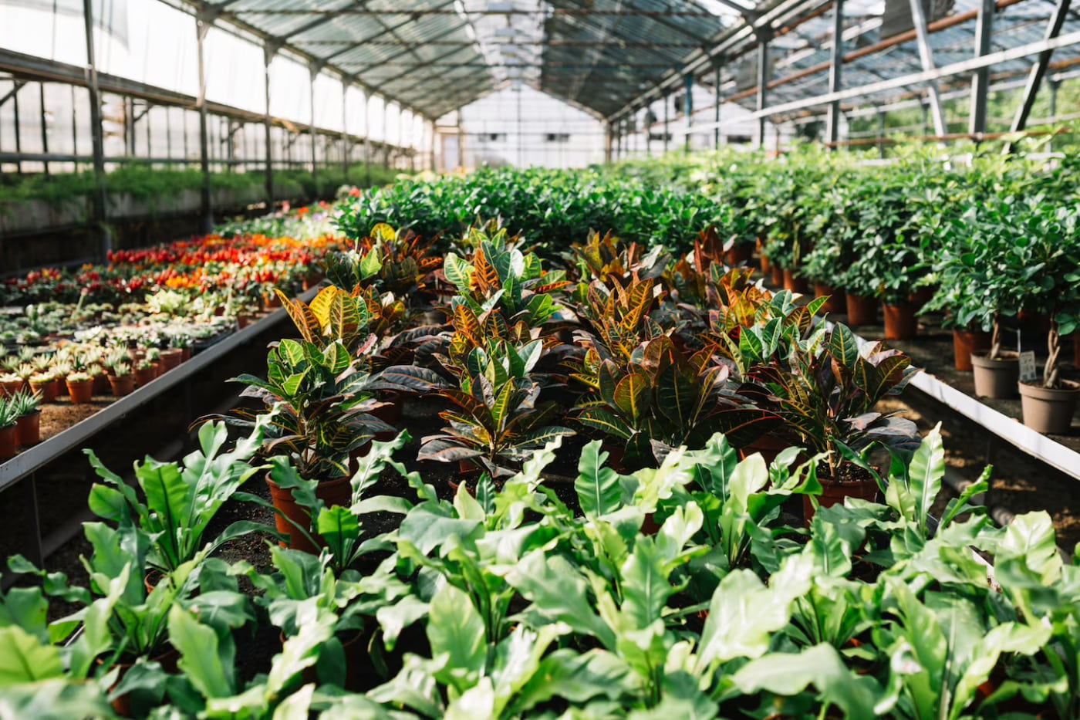
Why did we choose this project?
We chose this topic because plant health plays a crucial role in nursery management and agriculture. Many nursery workers are not equipped with the tools or knowledge to identify plant diseases early. By using modern technology, we aim to create an easy-to-use solution that helps them take timely action and reduce plant damage.

Slide 5
Problem Statement
Nursery workers and small-scale plant caretakers often lack the tools and technical knowledge to accurately identify plant diseases at an early stage.
Late or incorrect disease detection.
Spread of infections to healthy plants.
Financial losses due to damaged plants.
Dependence on experts, which may not always be accessible.
Existing detection tools are expensive and not tailored for small-scale nursery environments.

Slide 6
Objectives
To ensure clarity of purpose, we outline the key objectives of this project, highlighting what we aim to achieve through our innovative solution.
To detect plant diseases using uploaded or captured leaf images through a trained machine learning model.
To identify weather the plant is healthy or infected.
To display symptoms associated with the detected disease to help users understand the condition.
To provide recommendations and preventive measures to guide users on how to manage or avoid the disease.
To generate and download a detailed PDF report containing image, disease name, symptoms, and suggestions for record-keeping.

Slide 7
Project Scope
The scope of this project defines the boundaries and extent of the solution, ensuring focused development and measurable outcomes.
Develop a user-friendly mobile application for nursery-based plant disease detection using AI-powered image analysis.
The application is targeted primarily at nursery workers, plant enthusiasts, and small-scale farmers.
The app will feature an easy-to-use interface for nursery owners, Includes features like image upload, capture the leaf image, check symptoms and related treatment to it.
Deliver clear results, indicating whether the plant is healthy or affected by diseases such as bacterial spots.

Slide 8
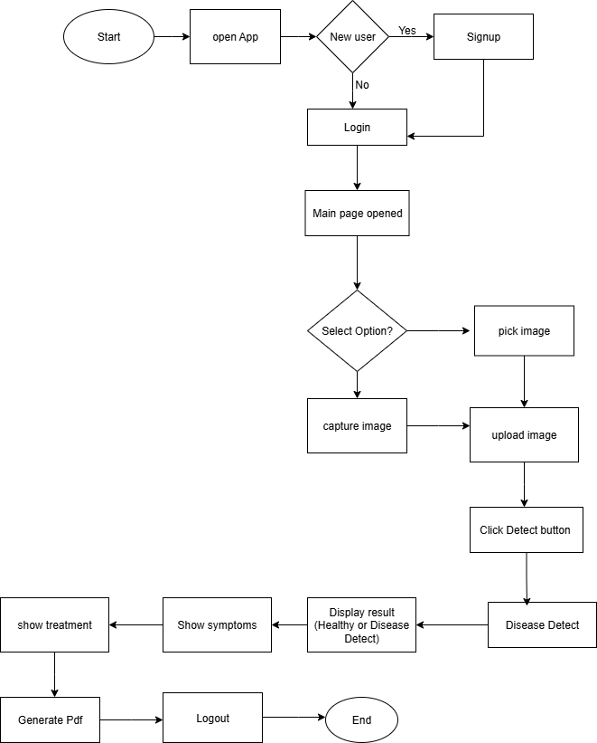
Flowchart

Slide 9
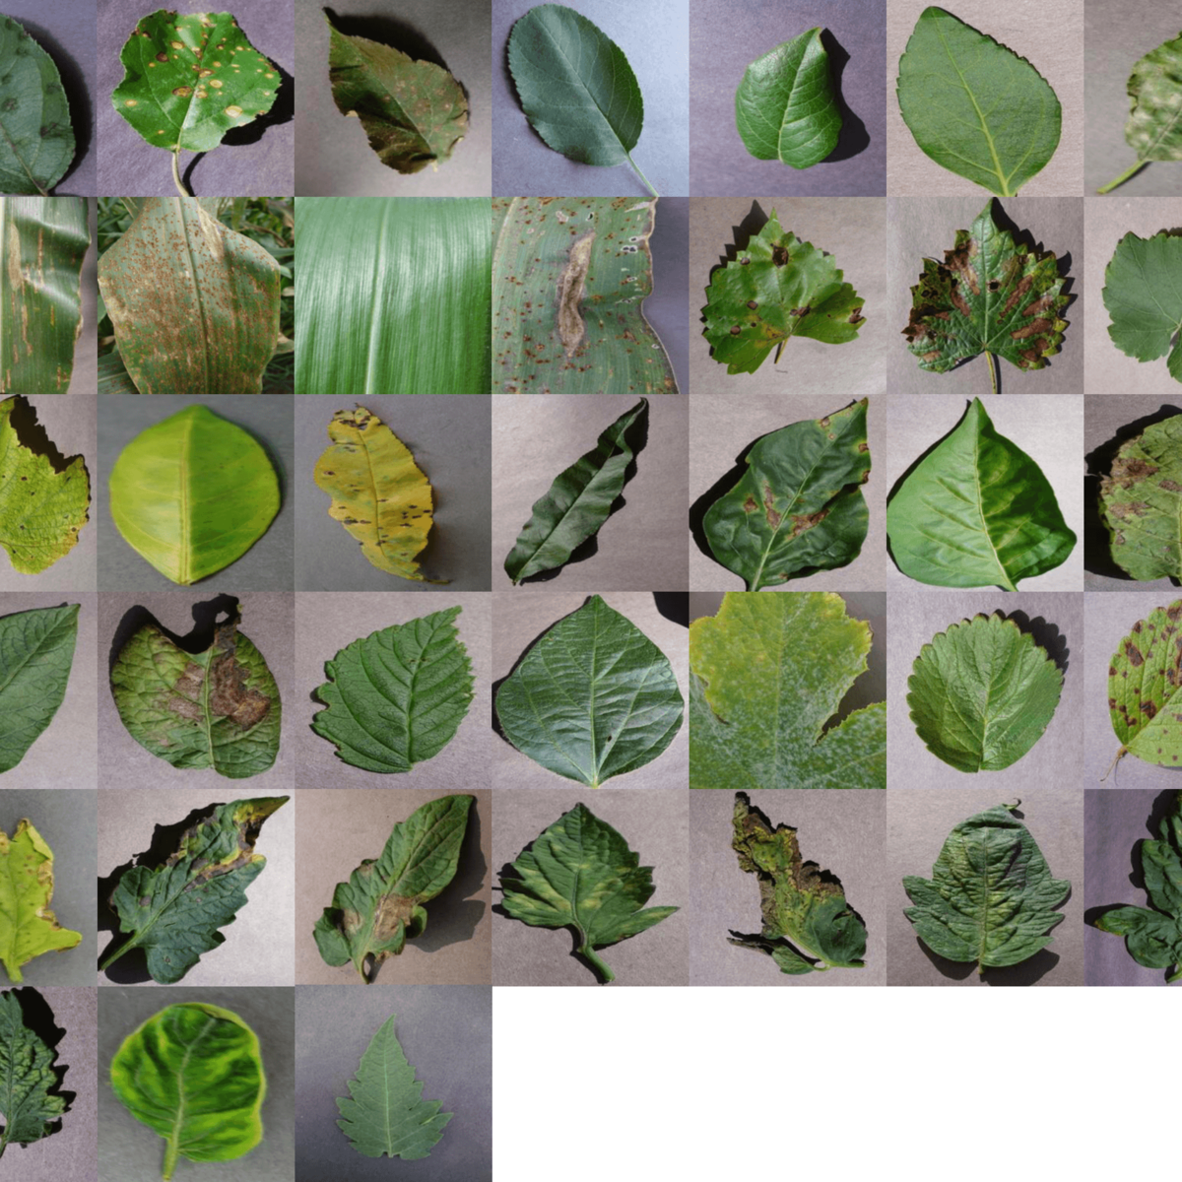
Dataset Overview
Dataset Used: PlantVillage Dataset
The PlantVillage dataset is a publicly available image dataset created to support research in plant disease classification using machine learning.
Total Classes: 38 different categories including healthy and infected leaf classes.
Training Images: 43,456
Validation Images: 10,849
Image Types: Color, Grayscale, and Segmented versions available.

Slide 10
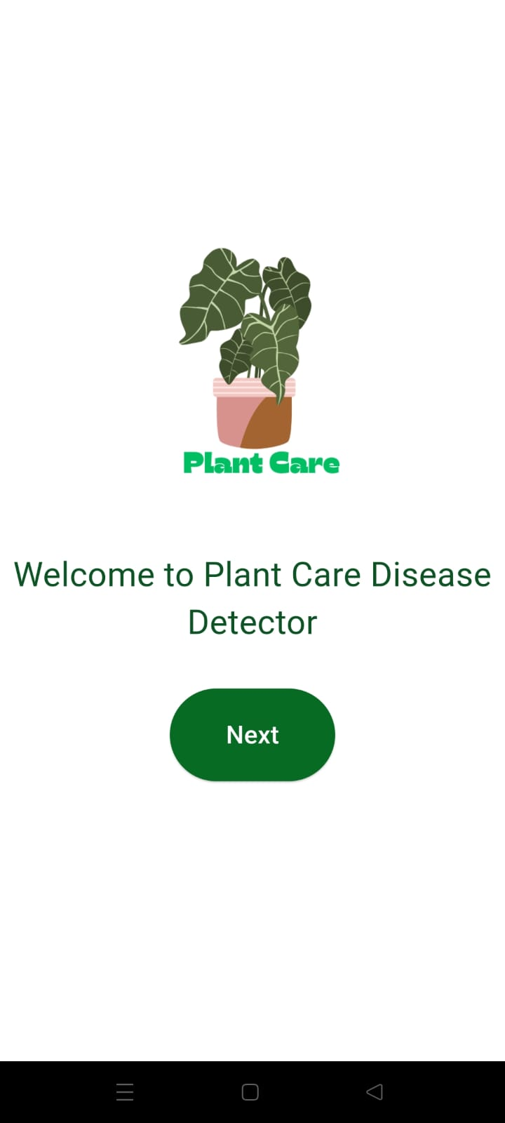
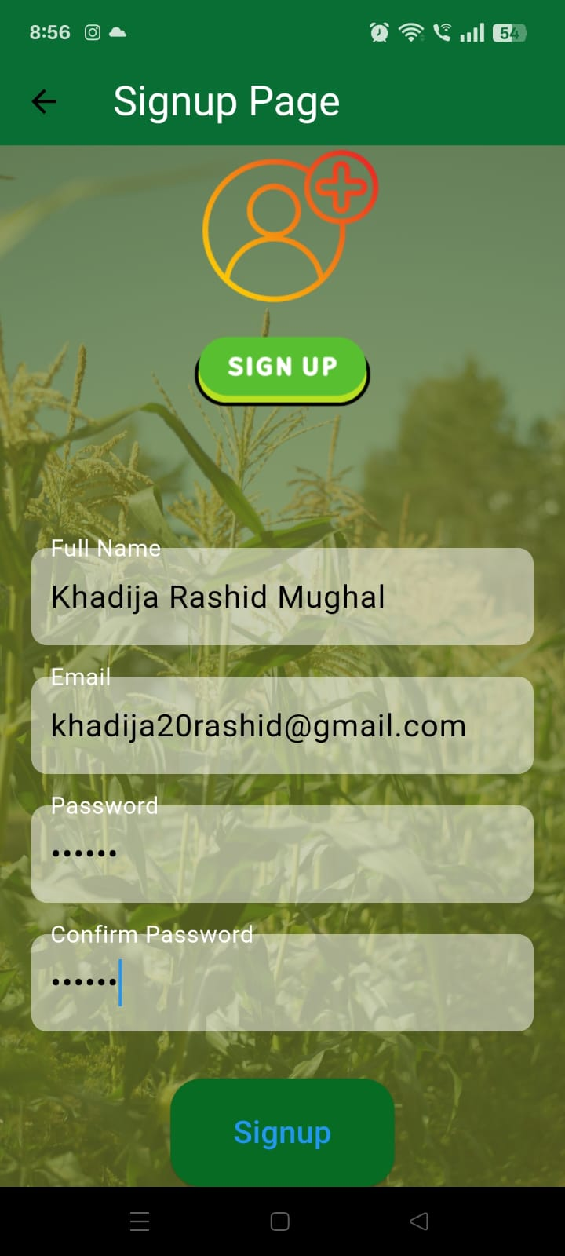
Application UI

Slide 11
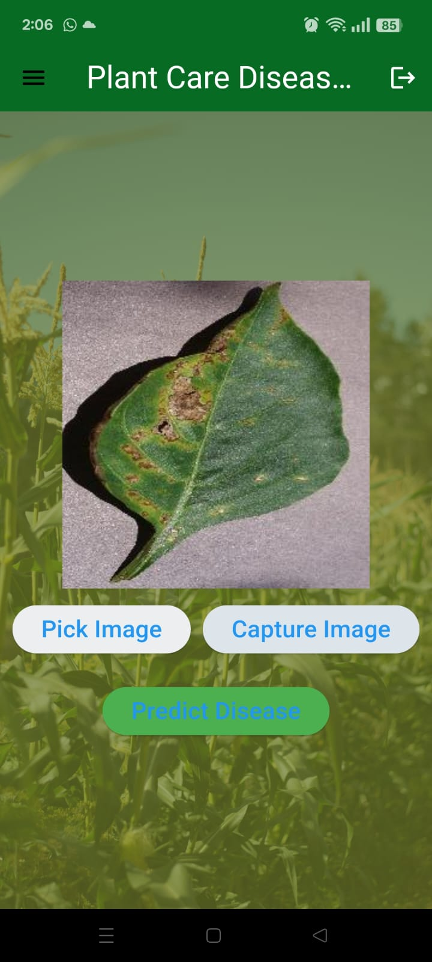
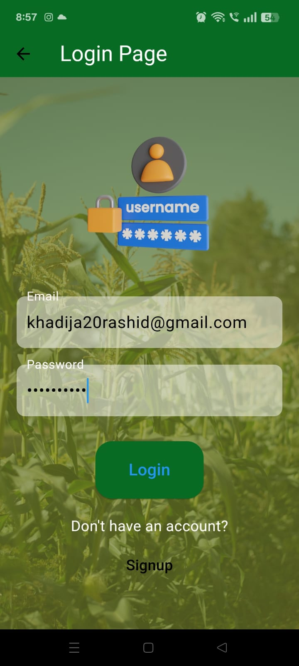
Application UI

Slide 12
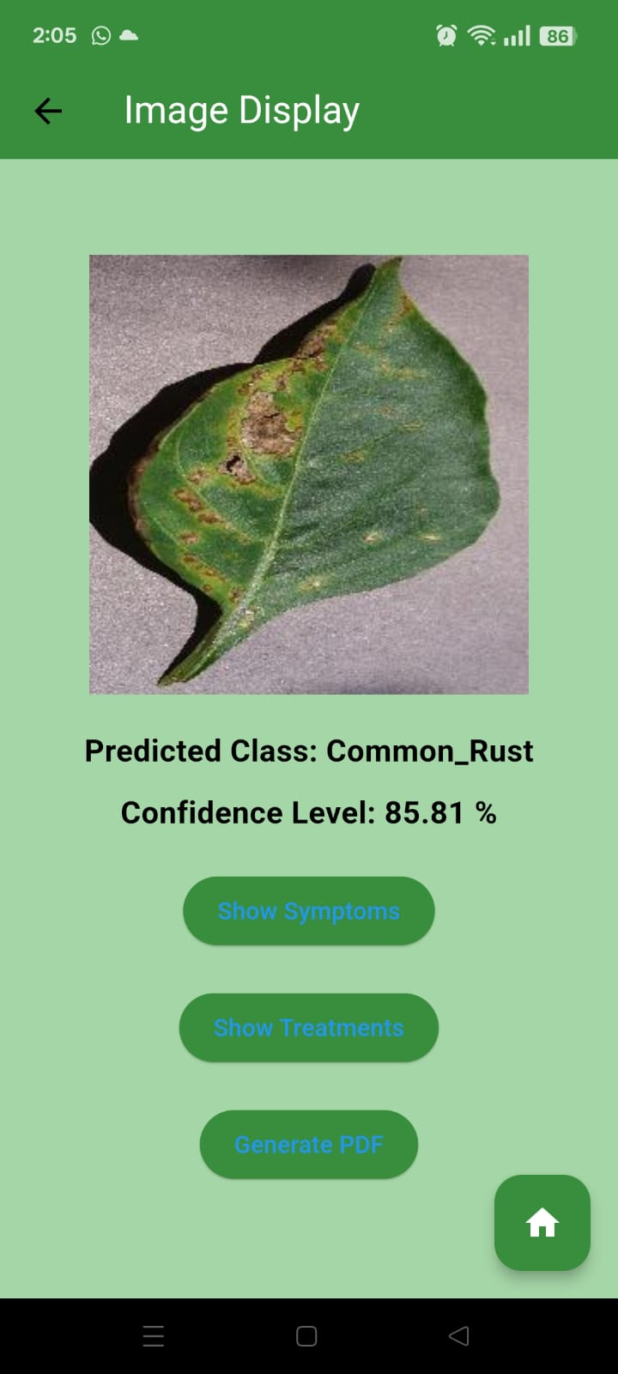
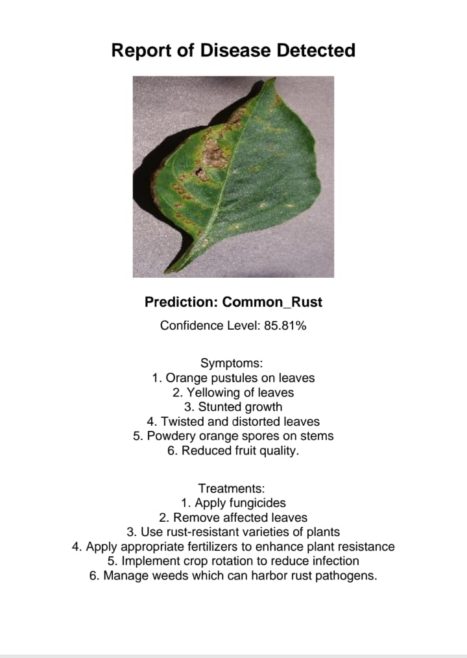
Application UI

Slide 13
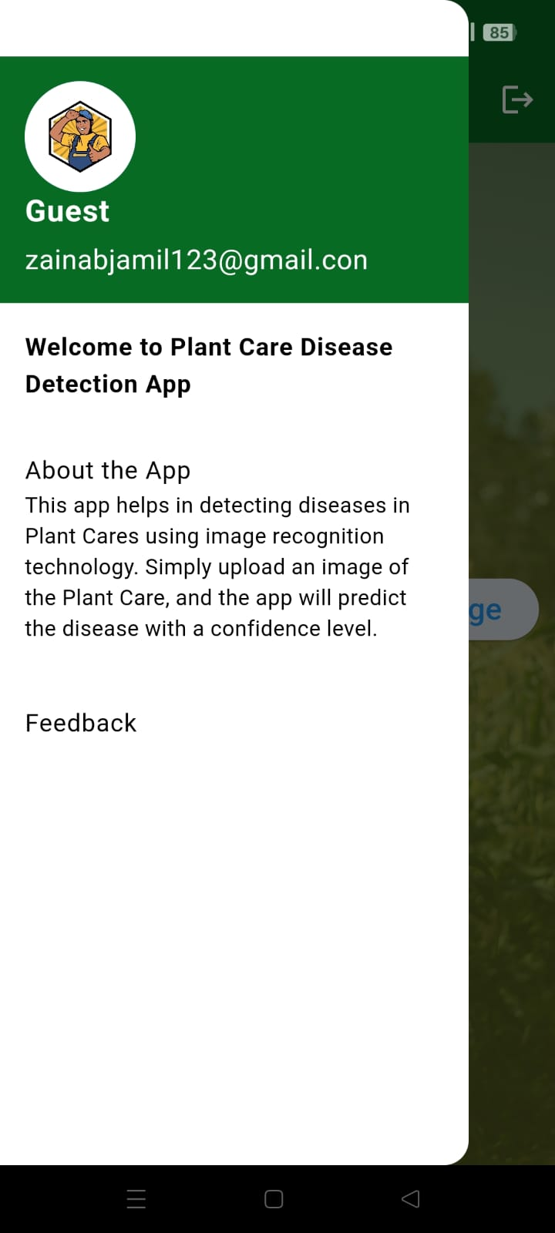
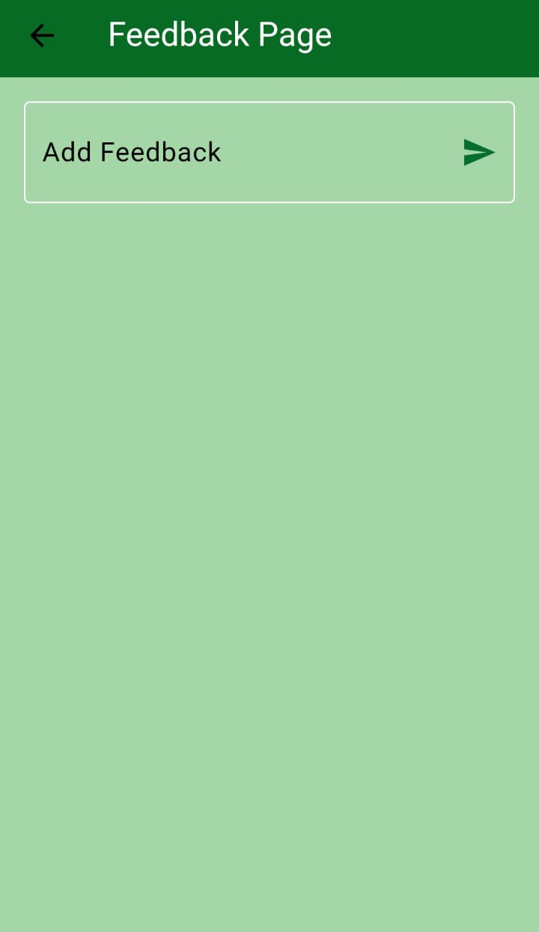
Application UI

Slide 14
Future Work
As technology advances and user needs increase, there is always scope to improve the capabilities of the Plant Disease Detection Mobile Application.
Add multilingual support to make the app usable for non-English speakers.
Enable offline functionality to allow disease detection without internet access.
Expand the dataset by including more plant types and diseases.
Improve user interface based on feedback for better navigation and experience.

Slide 15
Conclusion
Developed a mobile application to detect plant diseases using leaf images.
Integrated a machine learning model for predictions.
Provided features like symptom display, treatment recommendations, and PDF report generation.
Solved the real-world problem faced by nursery workers in early disease identification.
Enabled timely decision-making and improved plant health management through a simple, user-friendly interface.

Slide 16
References
[1] W. B. Demilie, J. Greening, K. Scab, and L. Melanose, “Plant disease detection and classification techniques: a comparative study of the performances,” *Journal of Big Data*, vol. 11, no. 5, 2024, doi:10.1186/s40537-023-00863-9.
[2] G. Shrestha and M. Das, “Plant disease detection using CNN,” *2020 IEEE Applied Signal Processing Conference (ASPCON)*, 2020, doi:10.1109/ASPCON49795.2020.9276800.
[3] N. I. Nivetha and M. Padmaa, “Tree leaves and fruits disease detection using convolutional neural networks,” *International Journal of Scientific Research and Engineering Development*, vol. 2, no. 3, pp. 1–6, 2018.
[4] A. A. Abdelmoamen and G. H. Reddy, “A Mobile‑Based System for Detecting Plant Leaf Diseases Using Deep Learning,” *AgriEngineering*, vol. 3, no. 3, pp. 478–493, 2021, doi:10.3390/agriengineering3030032.
[5] N. Bhise, S. Kathet, S. Jaiswar, and A. Adgaonkar, “Plant disease detection using machine learning,” *International Research Journal of Engineering and Technology (IRJET)*, vol. 7, no. 7, pp. 2924–2929, Jul. 2020.
[6] M. H. Saleem, J. Potgieter, and K. M. Arif, “Plant disease detection and classification by deep learning,” *Plants*, vol. 8, no. 11, Art. 468, 2019, doi:10.3390/plants8110468.
[7] T. Pandit, N. Thombare, R. Kazi, and M. Pangaonkar, “Smart plant disease detection,” *International Journal of Research Publication and Reviews*, vol. X, no. Y, pp. A–B, 2025.

Slide 17
ThankYou!

